Slide 1

A Service API for deployment
Steve Loughran
HP Laboratories
steve_loughran@hpl.hp.com

Slide 2
Goals
Public face of CDDLM "Basic Services"
Widely usable deployment API
Language agnostic
Use core WS-I SOAP, if possible, for interoperability
Be rigorous (WSDL-first)
Be extensible
Explore what works, what doesn’t
Notes:
Last point is key. This is exploratory. Feedback welcome :)

Slide 3
Implementation
Java based
Uses Apache Axis 1.2beta for SOAP
Built on SmartFrog
Hosted in SmartFrog (Axis Component, CDDLM component supplies a new endpoint)
Mildly Asynchronous (worker threads for notification callbacks)
Not yet finished!

Slide 4
XML Layer
SOAP1.2/1.2
XSD first, then WSDL
Six operations:
deploy, undeploy, serverStatus, applicationStatus, setCallback, lookupApplication
~2000 lines of XML Schema!
Notes:
That's a lot of XML Schema. Partly that is from all the xsd:annotations, which persist into the generated source, and so are

Slide 5
JSDL Support
JSDL document can be included in the deploy request
Purely informative.
No coupling of stdin/stdout

Slide 6
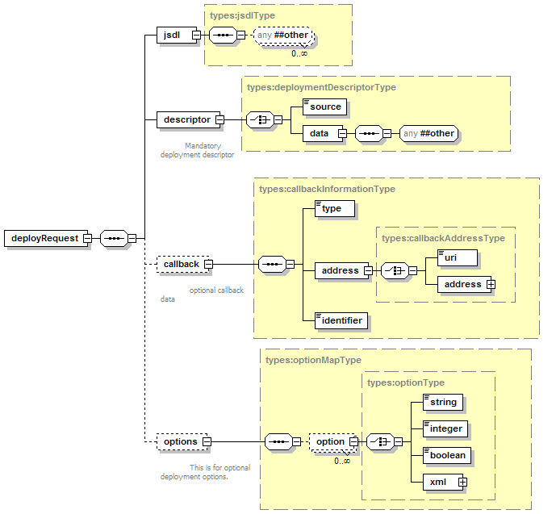
Deploy

Slide 7
Callbacks
Lifecycle events
ApplicationURI + caller supplied identifier
Application Status
Faults can be included inline

Slide 8
Trouble with Callbacks
  No standard callback mechanism
  WS-Notification v. complex
  WS-Notification/WS-eventing convergence?
  Firewalls?
  Jabber/XMLPP goes through firewalls
  Prototype just has simple direct callback endpoint
  Set callback on deploy()
  setCallback() operation sets a callback on a running application
  setCallback(null) to unsubscribe.
  notifications are queued; failures ignored.

Slide 9
Issue: Faults
Not using WS-BaseFaults: too inflexible
"BaseFault does NOT include open element extensibility"
requires explicit typing of all possible fault content
requires explicit naming of all throwable faults
the "checked exception" pattern
using classic SOAPFault
constants.xml declares fault codes
Notes:
First issue of controversy.
I like some aspects of WS-BaseFault: chaining model, explicit inclusion of address.
But it is like Java exceptions: you need to declare everything you can possibly throw. This is too restrictive for a generic interface.
The sole workaround is to declare a 'generic' extensible type and stick everything inside, but if you do that, why not stick with the broadly interoperable SOAPFaults. Which is what we did.

Slide 10
Not yet addressed
Logging
  need dynamic reconfig of running logs
  feeding of log data (buffered?) to monitors
  caching of data for polling
Code/data file provisioning
  assume portal copies files to shared file system
  could handle attachments, though that is an interop black spot.
Security
  (other than HTTP Authentication)

